Slide 1
SealTalk 即时通信软件
——https://github.com/sealtalk/sealtalk-android
Notes:
So today I am going to introduce our work on the project- SealTalk-Android

Slide 2
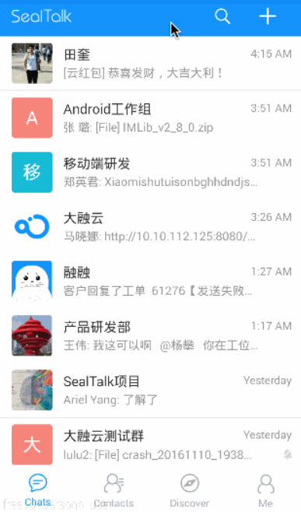



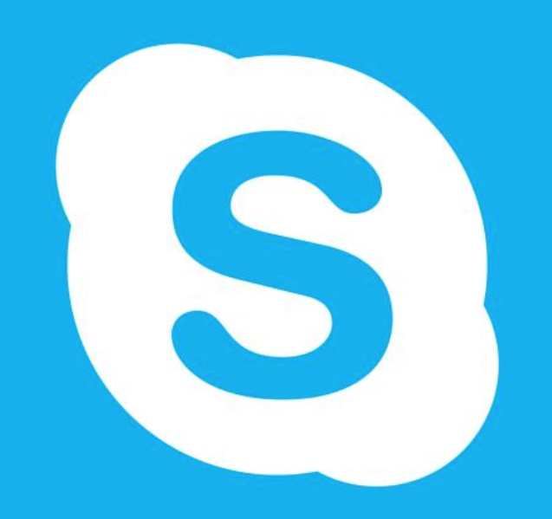
Introduction
SealTalk is an open source instant messaging App based on the Rongyun Instant Messaging SDK.
Notes:
SealTalk is an open source instant messaging App based on the Rongyun Instant Messaging SDK.
Typical Instant messging apps are listed as below, including QQ, WeChat, WhatsApp and Skype

Slide 3
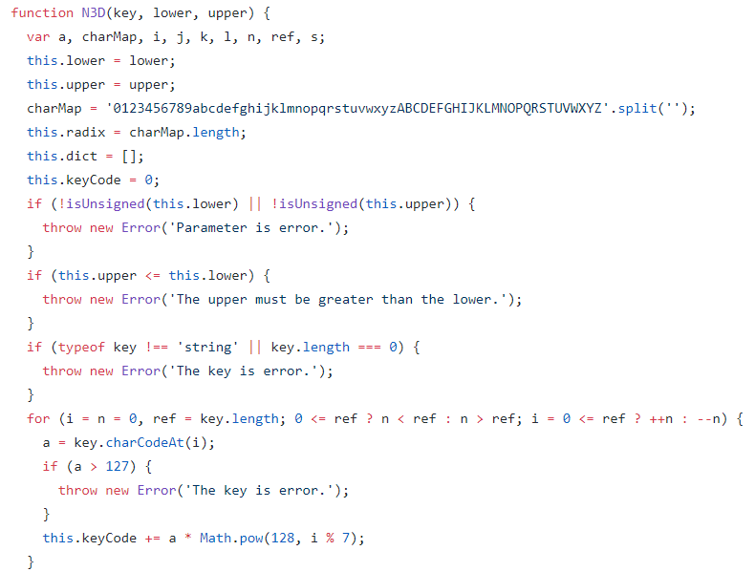
Non-functional requirements
Scalability
Error log
Reliability
Data Transmission Security
…
Notes:
Instant messaging platforms usually have the following non-functional requirements:
The first is scalability, which means Developers should reserve enough upgrading interfaces, and embody in the system design architecture to meet the future requirements of the system.
The second is Error log. It can facilitate system debugging and maintenance upgrade.
The third is Reliability. We all know that TCP is a reliable transport layer protocol, however The reliability of network layer is not equal to The reliability of application layer. We can say the channel between client and server is reliable, but we are not sure that the client and server themselves are reliable.
The last is Data Transmission Security. certain encryption technology must be adopted to ensure the absolute security of the user's sensitive private data after being put into use.
In this project, the server side is implemented by NodeJs. And we can find this encryption function in its source code, which ensures the Data Transmission Security

Slide 4
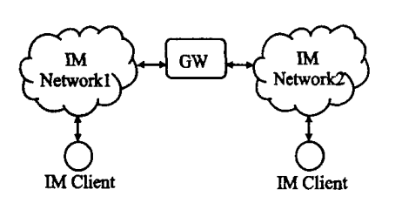
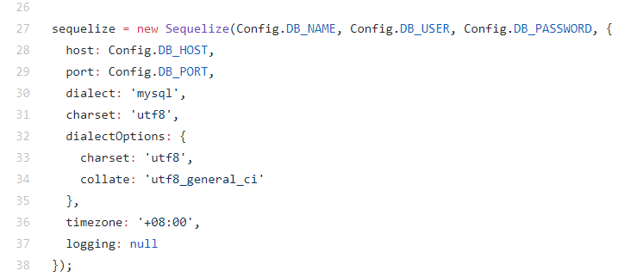
Design decisions
Msg Server
User A
User B
…….
User X
Protocols
IMPP
PRIM
SIP
XMPP
Scalability &
Flexibility
Notes:
A typical design of Instant Messaging is a C/S architecture based on Asynchronous communication technology. As is shown in this figure, an IM client communicates with another client throught the IM networks which connected with gateways.
However, the actual implementation in this project is like this. I don’t think this is a good design decision, because as the number of users grows larger and larger, a single server is not enough to meet the needs. If I had more time, I would put forward some of my personal suggestions. I think the only reason for this design decision is that the decision maker knew there will be only a few users using this app.
There are 4 mainstream protocols in Instant Messaging : IMPP/PRIM/SIP/XMPP which stands for Extensible Messaging and Presence Protocol; here we adopts XMPP, since it has relatively outstanding scalability and flexibility.
As we can see in its source code, it uses MySql as the database managing system. We can clearly see it actually uses a single database in its architecture. I think it should introduce appropriate Redundant backup to ensure storage high availability.

Slide 5
Stakeholders
Acquirers | RongCloud provides real-time communication cloud services. They release SealTalk-android as a demo application for their cloud services.
Users | Users could use it as a tool for personal communication, or to send message in a company. Notice that SealTalk’s basic function are built for general usage, enterprise user may need to modified their part.
Suppliers | SealTalk-android is built upon Java, and deployed on Android. They use Android Studio as development environment.
Development & Testing | In GitHub record, most of the early commit are given by jenkinsrc and Jianli Zhou. They are the employees of RongCloud Inc. RongCloud has assigned a group of nearly 5 people to develop SealTalk-android.
Competitors | QQ and WeChat are strong competitors to SealTalk who provides similar services and have a much wider user.
Maintainers | Commits that submit later are mainly given by rc-huangxiujun, an employee of RongCloud. There is not so much fork record on GitHub, but individual developers may customize SealTalk-android for their purpose.
Notes:
All of the above is the architecture of its server side. Now lets move to the Software Architecture of its Android Application.
Firstly, we analyzed the stakeholders.
Which include Acquirers/Users/ Suppliers /Development & Testing/Competitors/Maintainers
In the stakeholder analysis, many different actors with distinct roles, power and interest have been analyzed.

Slide 6
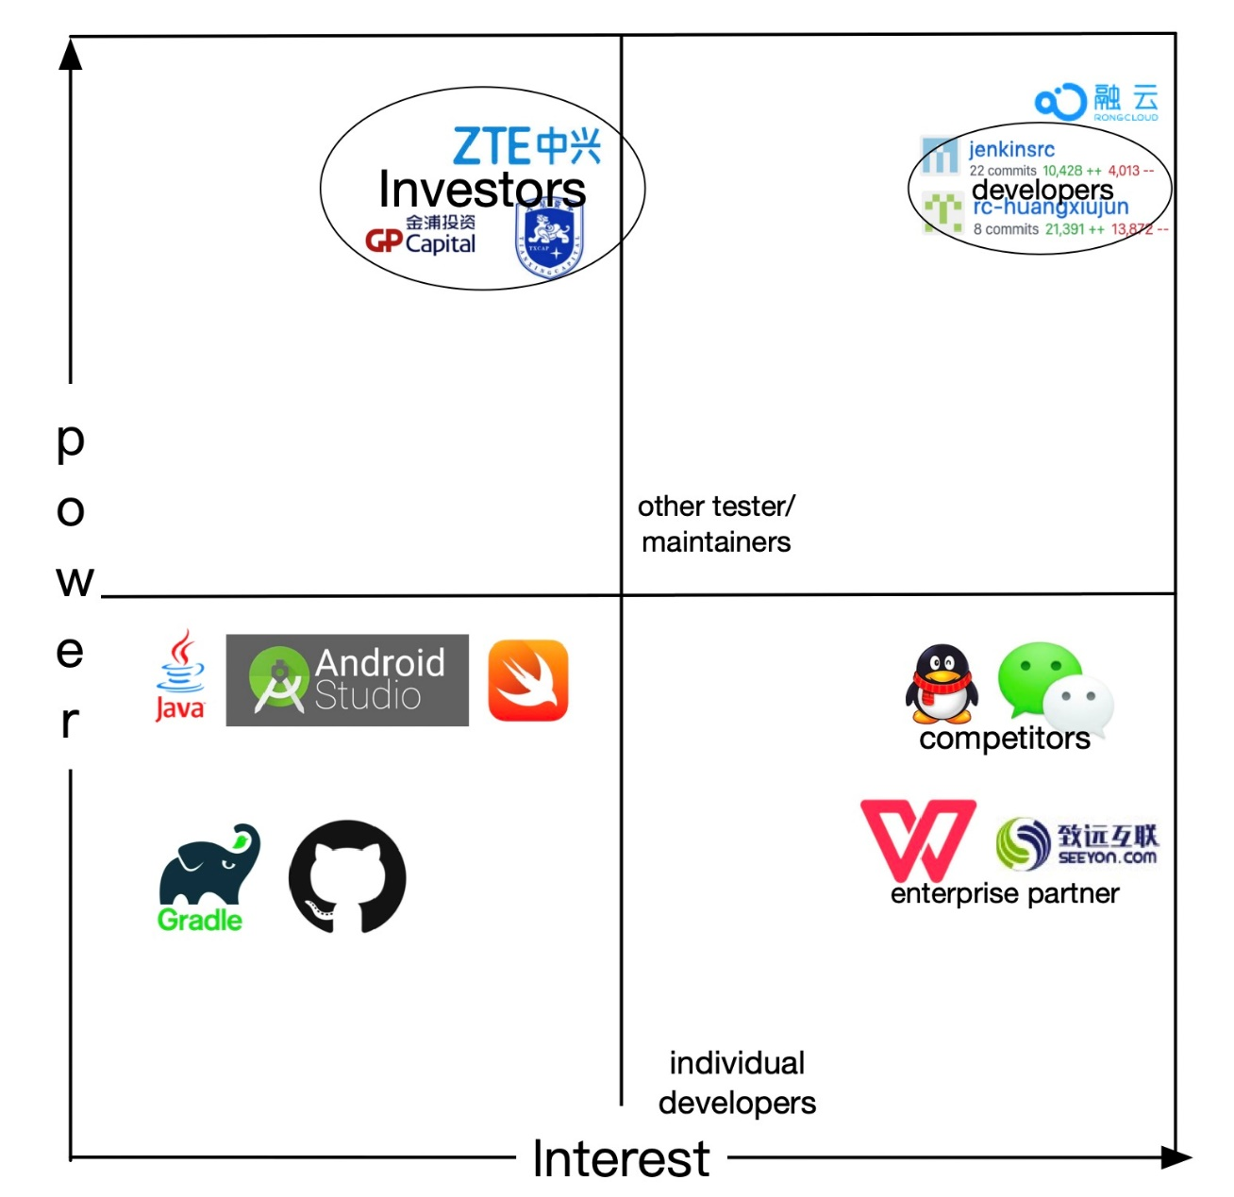
Power-interest
Notes:
The two less powerful stakeholders are the users and the competitors, while competitors have the highest interest, like QQ, Wechat. These applications also offer in-time communication service.
Apparently, they want to figure out how the SealTalk performs, what technologies are included and its advantages and shortcomings. Companies who use SealTalk are considered to have more power than individual users,for example WPS, SEEYON, since the cooperation among companies will force RongCloud to optimize their products and implement more functions, thus providing higher services.
Individual developers using Seal Talk may be considered have least power and interest less then company users.

Slide 7
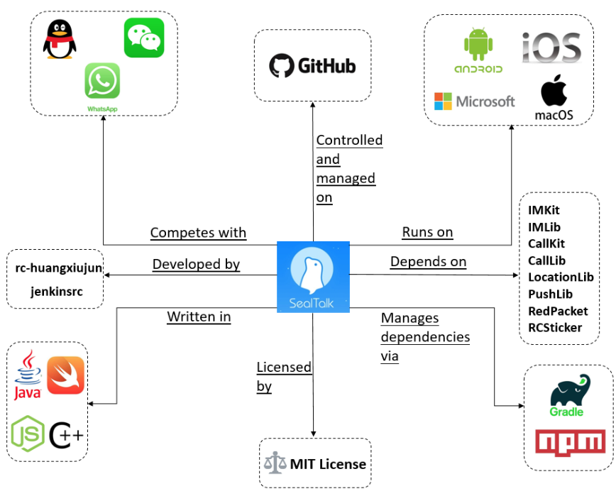
External Entities
Notes:
The context model of SealTalk is illustrated in this Figure. This modeling figure depicts SealTalk in the center, surrounded by the external entities it interacts with.
We can see that SealTalk runs on many kinds of platforms, including Android/ios/windows/macOs. Respectively, they are written in different programming languages like java for Android/swift for ios/Javascript for server side/ c-plus-plus for desktop.

Slide 8
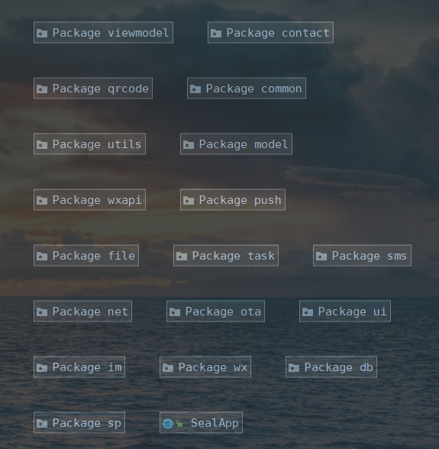
Module structures
Package Name | Function
common | Encapsulate url, error code and other constants
contact | Phone contact management
db | Database management, using the Room framework
im | Instant messaging implementation
model | Data layer, providing various data services for the upper layer
net | Encapsulate network request operations, using the Retrofit framework
ota | Online updating tools
viewmodel | Bridging View and Model, data returned via LiveData
sms | Short message service
task | Different Tasks are encapsulated according to different interfaces or data attributes
ui | The View layer
Notes:
From a Module structures perspective, I list the following packages and their functions.
For example, the db package is for Database management, using the Room framework. Room is an orm as known as Object Relational Mapping framework.
The net package Encapsulate network request operations, using the Retrofit framework, A type-safe HTTP client for Android.

Slide 9
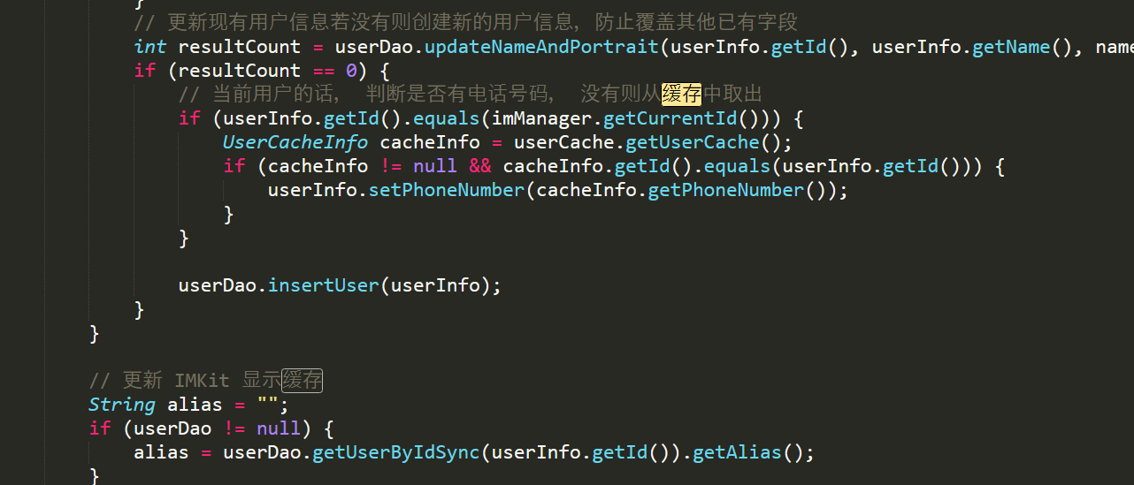
Design decisions
ViewModel
UI updater
Request Data
Observers
LiveData
LiveData
Cache
New Data
Task
Remote data
Save Remote data
Query
Cache
Request
step1
step3
step2
Server
Database
Database
Notes:
This is the Data request process, when it is a Network request and cache is required.
Among them, ViewModel's LiveData follows the observer pattern. LiveData will notify the Observer when the lifecycle state changes. You can merge the code that updates the UI into these Observer objects. Every time the data changes, Observer will update the User Interface.
Note that here in the Task layer, the database will be queried first, then the cached data in the current database will be returned, and then the server will be requested to obtain the latest data, and then the new data will be saved to the database. Finally, a database query will be performed to obtain the latest data in the database. The code corresponds to the following

Slide 10
Thanks for watching!
Notes:
That’s all. Thanks for watching.

